Slide 1

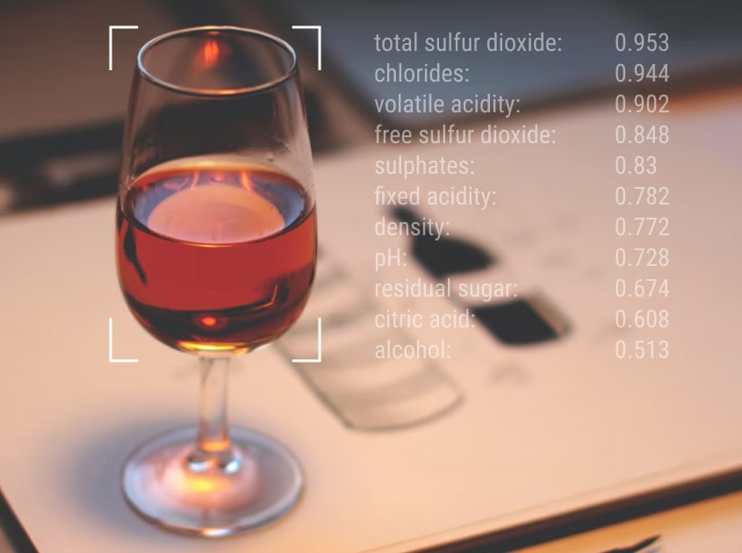
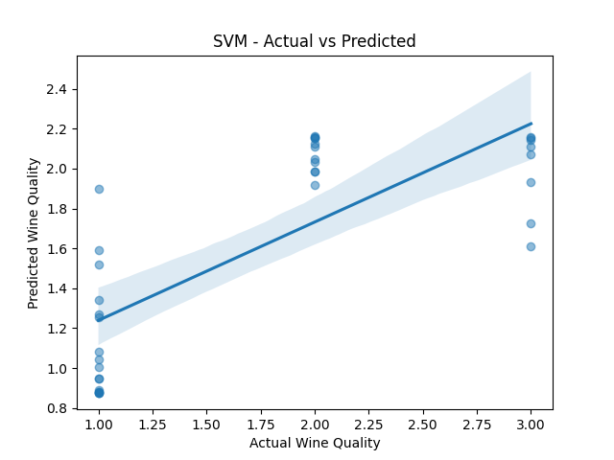
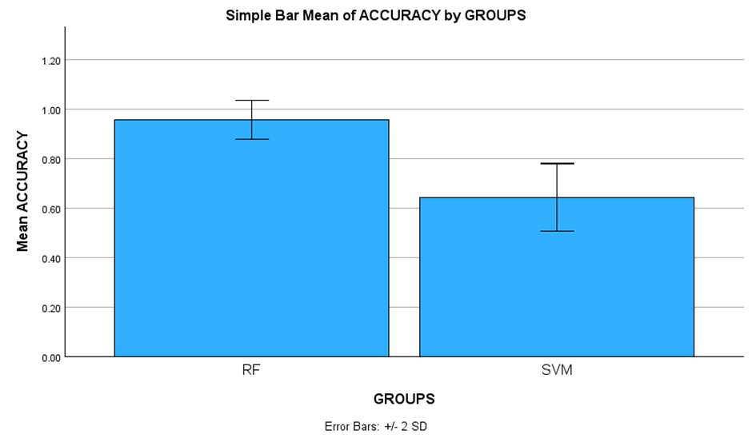
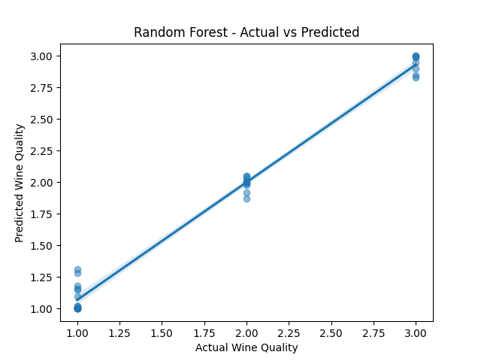
Name: Ms. Kaviyashree J Register Number: 192121003
Guided by Dr. M Ramkumar
Ms. Poorani.S
Guided by Dr. Mary Valantina. G
Effective Analysis of Wine Quality Prediction Using Random Forest Regression In Comparison with
Support Vector Machine Regression
INTRODUCTION
Wine Quality Prediction refers to the analysis of the quality of wine based on heap of factors including grape assortment , climate conditions, maturation strategies and mature forms .
The aim of this study is to give high accuracy in predicting the quality of wine using the different chemical compositions present in the wine as parameters .
By comparing the execution of Random Forest Regression with that of Support Vector Machine Regression, we point to supply nuanced experiences that can direct specialists and analysts in optimizing prescient modeling techniques for wine quality appraisal.
Random Forest Regression has proven to be faster when compared with Support Vector Machine Regression.
Wine Quality Prediction based on the Chemicals present
MATERIALS AND METHODS
80 % of the Data is used to Train and 20 % of Data is used to Test
Random Forest Regression and Support Vector Machine Regression
Required Data Set Collection
Importing Libraries
Feature and Target Separation
Split the Data to Train and Test
Train the Model using Algorithm
Test the Prediction to get Accuracy
Wine Quality Prediction
RESULTS
Support Vector Machine Regression and Random Forest Regression
In the present work, Random Forest Regression (RF) is compared with Support Vector Machine Regression (SVM) , it depicts that the Random Forest Regression gives more accuracy when compared with the Support Vector Machine Regression .
DISCUSSION AND CONCLUSION
To analyze the Random Forest Regression and Support Vector Machine Regression methods, this data is used. Both of the necessary techniques, Random Forest Regression and Support Vector Machine Regression were subjected to statistical data analysis. Using group and accuracy data, machine learning algorithms are used to predict the accuracy of wine quality. These 10 data samples are used to create comparison statistics values for each algorithm they correspond to.
Based on T-test Statistical analysis, the significance value of p=0.001 (independent sample T - test p<0.05) is obtained and shows that there is a statistical significant difference between the group 1 and group 2.
Overall , the accuracy of the Random Forest Regression is 95.55 % and that of the Support Vector Machine Regression (SVM) is 65 %. From the work , it is concluded that the Random Forest Regression attains the high accuracy when comparing with Support Vector Machine in Wine Quality Prediction .
The results of this study provide enough information to use machine learning algorithms to pinpoint the precise impacts of effectively predicting the quality of wine.
BIBLIOGRAPHY
K. R. Dahal, J. N. Dahal, H. Banjade, S. Gaire . April 2021. “Prediction of Wine Quality Using Machine Learning Algorithms : Open Journal of Statistics .” Vol.11 No.2.
Don Kulasiri et al.,2022 Don Kulasiri, Piyush Bhardwaj, Parul Tiwari, Kenneth Olejar Jr, Wendy Parr “ A Machine Learning application in wine quality prediction .” Machine Learning with Applications , Volume 8.
Ashley Laughter (04 July 2020) “A Study of Modeling Techniques for Prediction of Wine Quality .”Intelligent Computing
Basvaraj. S. Anami (2022)“A Machine Learning Based Approach for Wine Quality Prediction.”
Aich et al.,2018 Aich S.,Al-absi A.A., Hui K.L., Lee J.T., Sain M. “A Classification approach with different features sets to predict the quality of different types of wine using machine learning techniques.” International Conference on Advanced Communication Technology, ICACT, 2018-February (2018), pp. 139-143.

